Slide 1
Unit 202: Principles of electrical science
Basic mechanics Mass and weight

Slide 2
Basic mechanics – mass & weight
Mass versus weight
Many people confuse mass with weight and frequently interchange each term but they are two distinct and different entities and we must be able to differentiate between them.

Slide 3
Basic mechanics – mass & weight
What is mass?
This is a measure of how much matter is in an object. This doesn’t change regardless of where the object is – on Earth, the Moon, Jupiter or floating around in space, the object’s mass will always be the same.
Points to not about mass:
Mass is indestructible. Wherever you are the mass will never change
Mass can never be zero otherwise it would not exist.
Mass is not related to gravity, centrifugal force, etc and these forces have no effect whatsoever on mass
The SI unit of mass is the kilogram (kg).

Slide 4
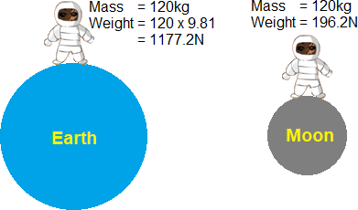
Basic mechanics – mass & weight
What is weight?
Unfortunately, the mass of an object is often referred to as its weight, though these are in fact different concepts and quantities. In scientific contexts, mass refers to the amount of ‘matter’ in an object, whereas weight refers to the force exerted on an object by gravity. In other words, an object with a mass of 1.0 kilogram will weigh approximately 9.81 newtons on the surface of the Earth (its mass multiplied by the gravitational field strength), since the newton is a unit of force, while the kilogram is a unit of mass.

Slide 5
Unit 202: Principles of electrical science
The End

